Slide 1
Opening a Japanese Restaurant in Toronto

Slide 2
Background
Toronto is the capital city of the province of Ontario, one of the largest cities in Canada by population with 2,731,571 residents as of
The majority of the Ontario residents live the the Greater Toronto Area which makes it Canada's most populous city
With the wide diversity in Canada and in the City of Toronto, there are many restaurants that offer almost every cuisine that exists on the planet
However, considering the increasing popularity of the oriental food, it is always a best idea to open an authentic Japanese restaurant

Slide 3
Problem
Opening a new restaurant in the city would require a good understanding of the geography, neighborhoods and diversity of the city and the distribution of the restaurants on each side of the city that ranges from east to west and the center

Slide 4
Interest
Our study would require filtering all the venues to only work on venues that serve food, fast food or are just diner places or restaurants
Also the information will be filtered in order to see how many Japanese restaurants are in each area
Our study should decide which area would be best to open an Japanese restaurant

Slide 5
Data sources
For the Toronto neighborhood data, I will use the following Wikipedia page: https://en.wikipedia.org/wiki/List_of_postal_codes_of_Canada:_M
I will scrape the Wikipedia page by using BeautifulSoup and wrangle the data, clean it, and then read it into a pandas dataframe
The geographical coordinates of each postal code will be read in a pandas dataframe as well from: https://cf-courses-data.s3.us.cloud-object-storage.appdomain.cloud/IBMDeveloperSkillsNetwork-DS0701EN-SkillsNetwork/labs_v1/Geospatial_Coordinates.csv

Slide 6
Data cleaning
The both dataframes obtained will be merged together so that each neighborhood has its geographical coordinates assigned
I will use Foursquare APIs to fetch the data from all the venues in Toronto
Then I will filter the data to get only the restaurants/diners or food related venues to work on
The venue data obtained will help to find out which area is the best one to open a Japanese restaurant

Slide 7
Methodology
The data was scraped using BeautifulSoup and put into a dataframe as shown in Fig.1.
The second source of data provided us with the Geographical coordinates of the neighborhoods with the respective Postal Codes (Fig.2)
Both dataframes obtained were merged into one, so that each neighborhood has its geographical coordinates assigned (Fig. 3)
The retrieval of the location, name, category and food type about the restaurants in Toronto was collected through the Foursquare explore API
To obtain the data, it was required to make an account where it would provide a ‘Secret Key’ as well as a ‘Client ID’ which would allow me to pull any data

Slide 8
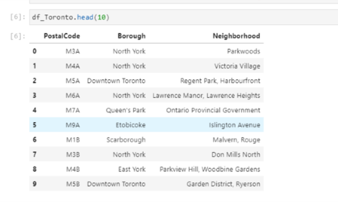
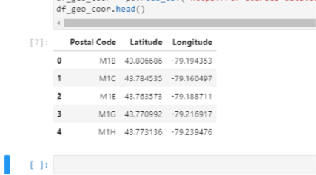
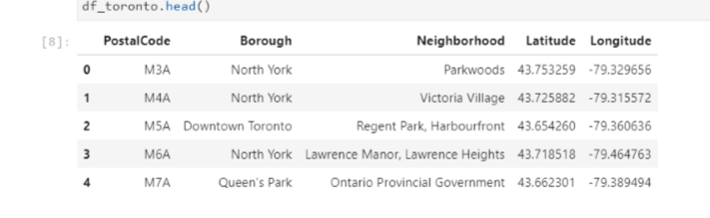
Fig. 1
Fig. 2
Fig. 3

Slide 9
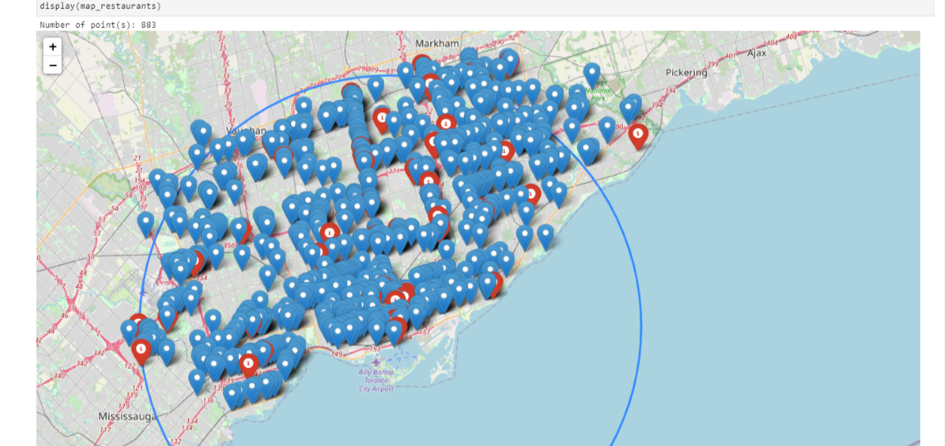
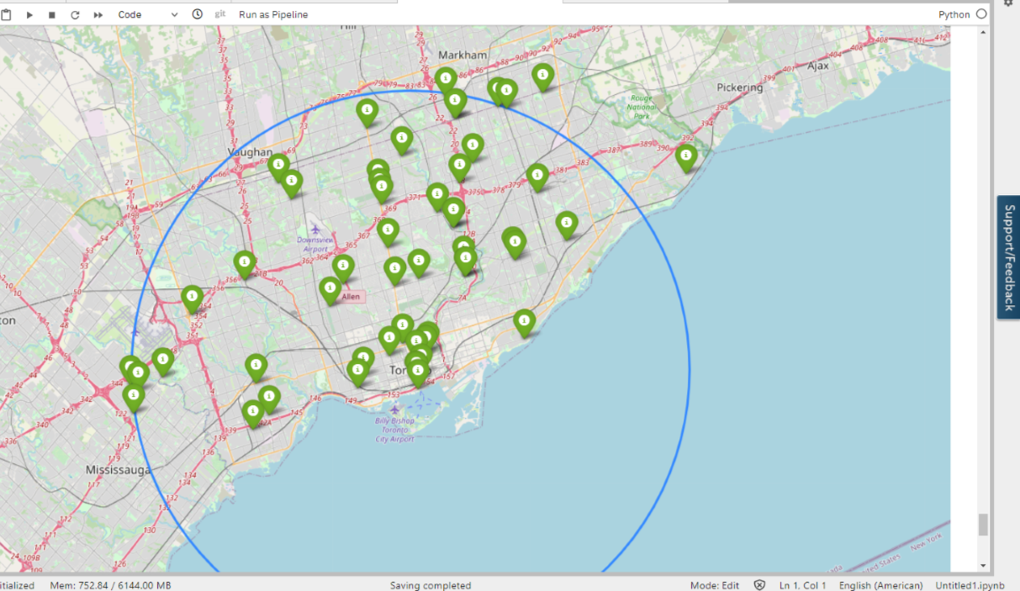
We created a map using folium and color coded the restaurants: the Japanese ones are marked with red
We then filtered the Japanese restaurants and then created a map with all of them in the entire Toronto
Fig.4
Fig. 5

Slide 10
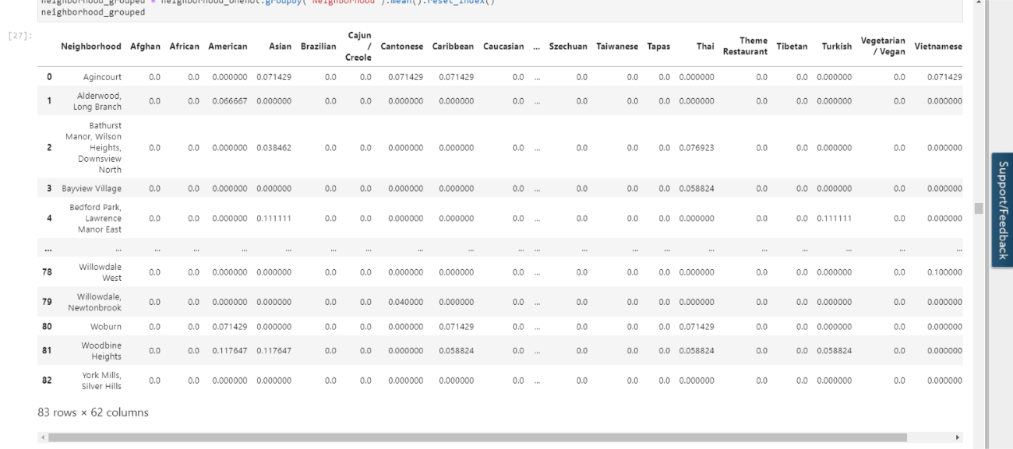
To analyze the data we performed a technique in which Categorical Data is transformed into Numerical Data for Machine Learning algorithms
This technique is called One hot encoding
For each of the neighborhoods, individual restaurants were turned into the frequency at how many of those restaurants were located in each neighborhood
Fig. 6

Slide 11
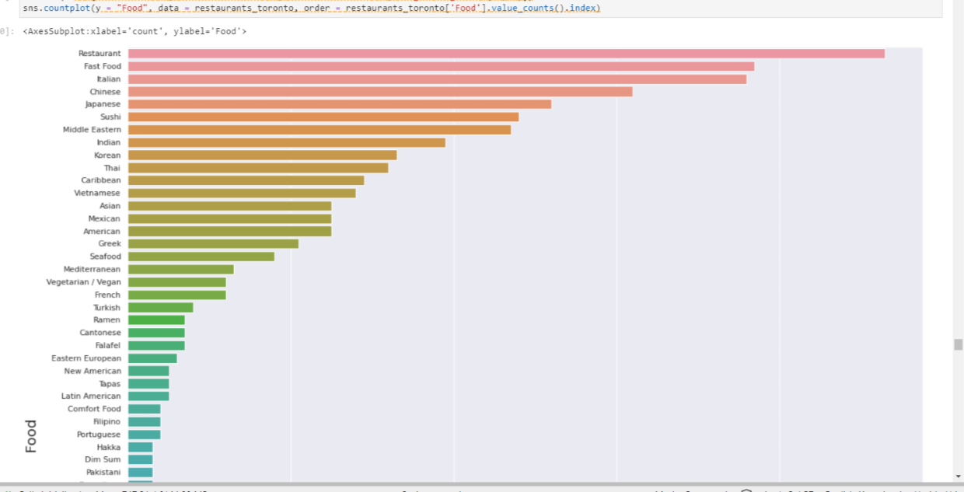
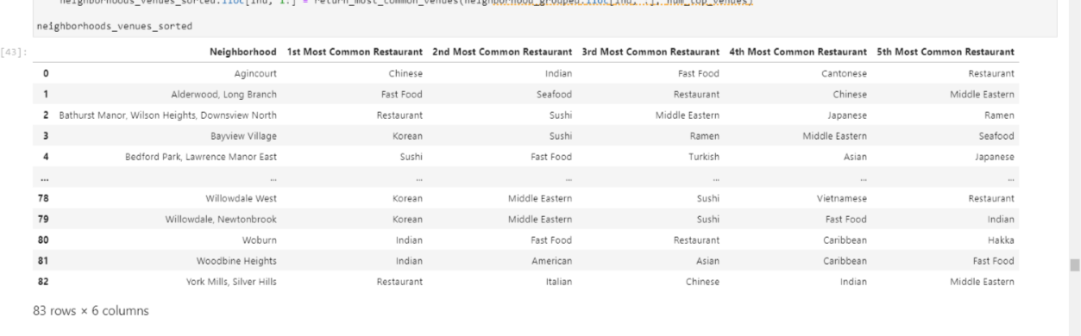
We then searched for the most commons restaurants for each neighborhood and overall. We can see that overall the Japanese Restaurants are on the 5th position.
Fig. 8
Fig. 7

Slide 12
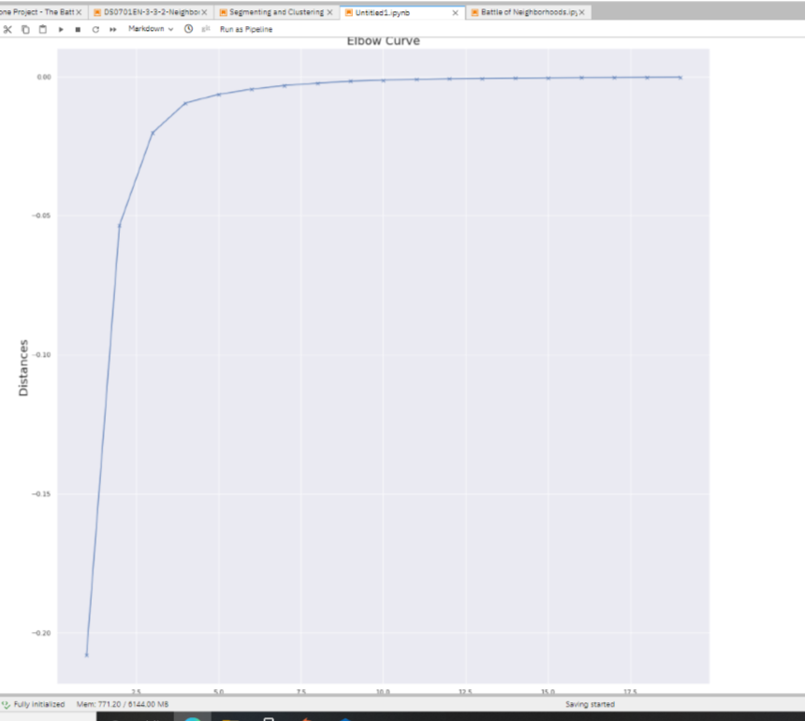
We also wanted to cluster the neighborhoods to see which has the most Japanese Restaurants
In this technique we ran a test with different number of K values and measured the accuracy and then chose the best K value
We see that the Elbow is at K=3
Moreover, in K-Means clustering, objects that are similar based on a certain variable are put into the same cluster
Neighborhoods that had similar mean frequency of Japanese Restaurants were divided into 3 clusters
Each of these clusters were labelled from 0 to 3 as the indexing of labels begin with 0 instead of
Fig. 9

Slide 13
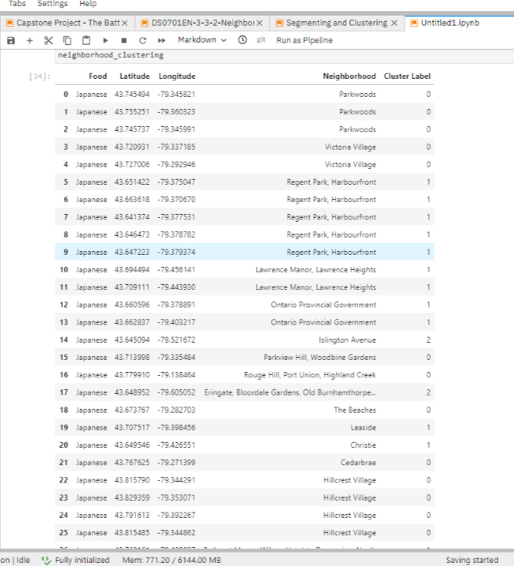
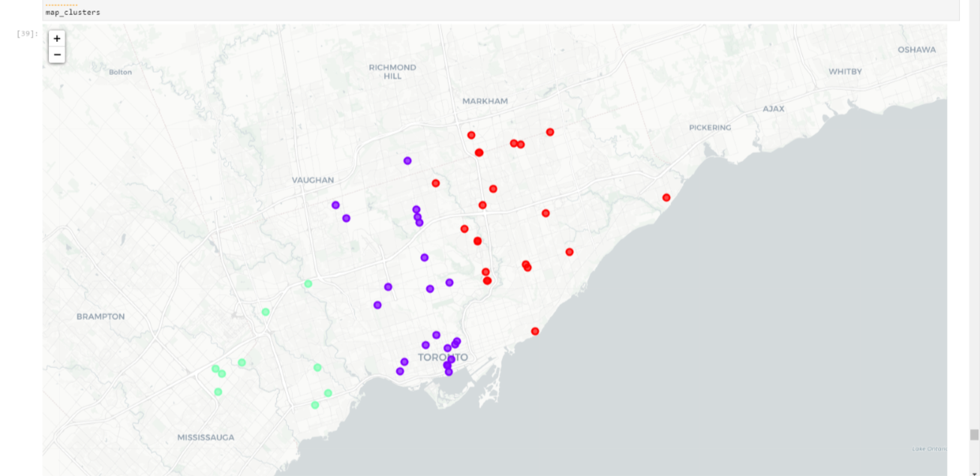
After, we merged the venue data with the table on the left creating a new table which would be the basis for analyzing new opportunities for opening a new Japanese Restaurant in Toronto. Then we created a map using the Folium package in Python and each neighborhood was colored based on the cluster label. For example, cluster 1 was purple and cluster 2 was green.
Fig. 10
Fig. 11

Slide 14
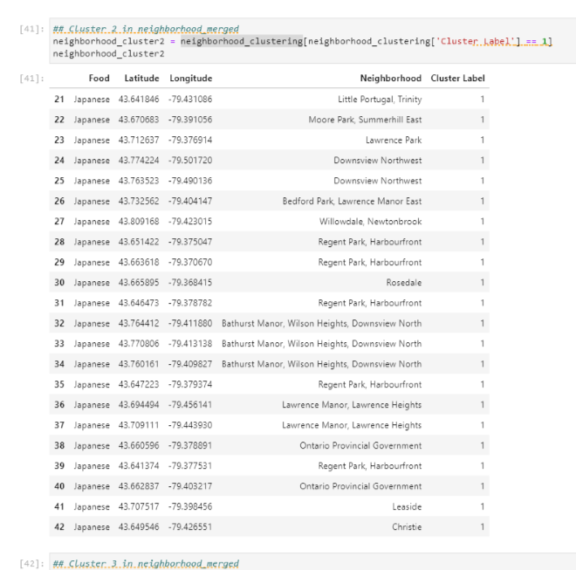
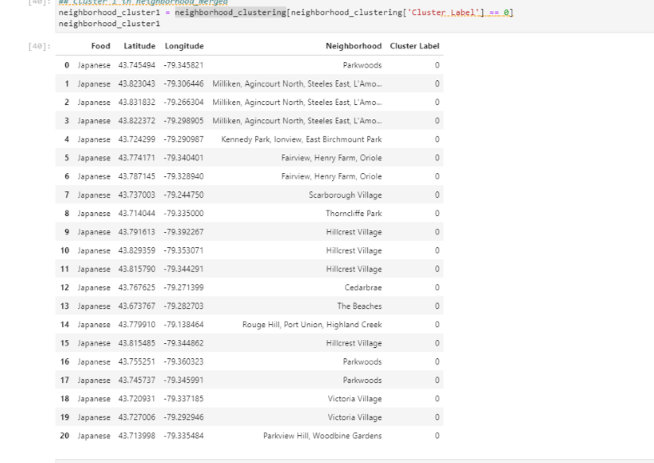
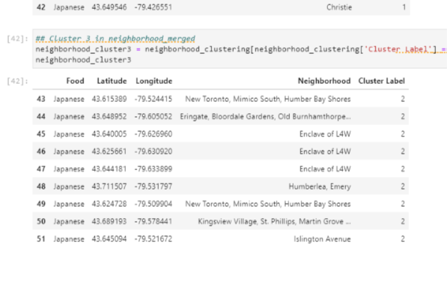
Fig. 12 Cluster 1
Fig. 13 Cluster 2
Fig. 14 Cluster 3

Slide 15
Discussion
Most of the Japanese Restaurants are in cluster 1 and cluster 2 represented by the red and purple clusters. The neighborhoods in these areas that have the highest average of Japanese Restaurants are Hillcrest Village and Regent Park.
We can see that in the cluster 3 there are significantly fewer Japanese restaurants. However, in this area the most restaurants are in Enclave of L4W.
Looking at the nearby venues, the optimum place to put a new Japanese restaurant is in the cluster 3 area as there are many Neighborhoods in the area but little to no Japanese restaurants.

Slide 16
Conclusion
In conclusion, to end off this project, we had an opportunity on a business problem, and it was tackled in way that it was similar to how a genuine data scientist would do
We utilized numerous Python libraries to fetch the information , to control the content and to break down and visualize those datasets
We have utilized Foursquare API to investigate the settings in neighborhoods of Toronto, get great measure of data from Wikipedia which we scraped with the Beautifulsoup Web scraping Library
We also visualized utilizing different plots present in seaborn and matplotlib libraries

